Slide 1
Session 2: Search Engine
Optimization and
its Components

Slide 2

What is SEO?
Purpose - bring organic traffic to Website
Process of increasing visibility of Web pages
Organic traffic – free traffic; from unpaid sources
Method to rank Web pages higher
Ensures genuine audience
Page Rank - Position of a Website in SERP
Increases quantity and quality of traffic
Higher Rank = High Quality Content

Slide 3
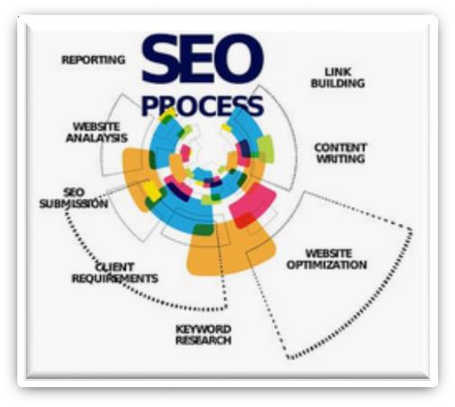
Basic Techniques of SEO
Process of identifying words
Keyword Research
Process of getting links from other Websites to one’s own site
Process of optimizing technical elements in Website for crawling and ranking
Link Building
SEO
Techniques
Technical SEO
On-Page SEO
Process of optimizing Web pages

Slide 4




Black Hat, White Hat, and Gray Hat SEO
Black Hat
White Hat Gray Hat
SEO practices created against search engine guidelines
SEO practices following search engine guidelines
SEO practices without defined
guidelines
Cloaking
Stealing Content
Keyword Stuffing
Displaying different content to
users and different content to search engines
Copying content from a
different Website and publishing on one’s own site
Overusing keywords in a page

Slide 5
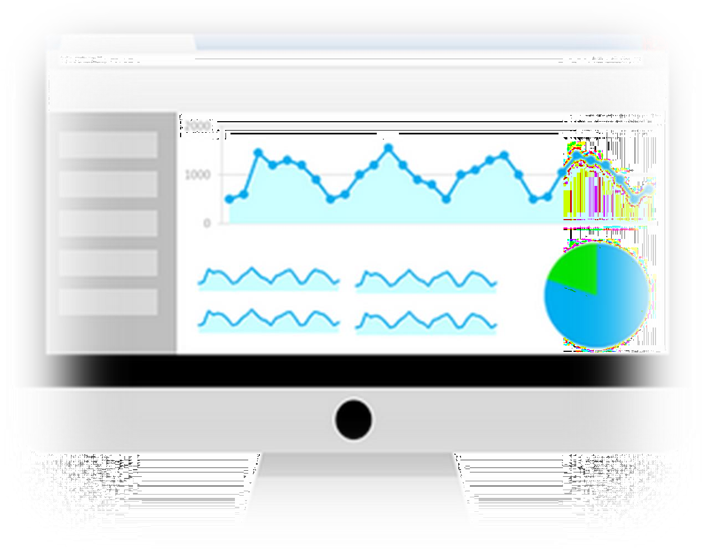
Understanding Google Search Console (1-2)
Setting up Google Search Console
Earlier called Google Webmaster Tools
1. Sign in to Search console.
A free service by Google
2. Verify site ownership.
Maintains site's presence in SERP
Helps view search traffic data
Add property type – Domain or URL prefix.
Inspect URL using tool.
Submit Website in Search console.

Slide 6

Understanding Google Search Console
(2-2)
Measures:
* Impressions: Viewed links.
* Clicks: Clicking link to page.
Performance Reports
* Click-through rate: Click Count/Impression Count.
Top-linked pages
URL
Inspection Tool
Links Report
Requests for URL to be crawled or recrawled.
Search Console Tools
Summarizes user experience.
Page Experience Report
Index Coverage Report
Information on indexed pages.
Sitemaps Report
Informs:
* About new sitemaps
Sitemap submission history
Errors

Slide 7

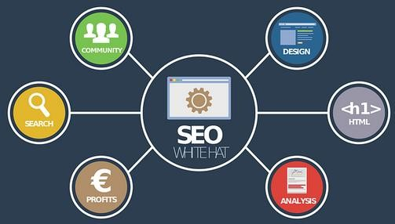
Google Search Console Guidelines
General Content Quality
Navigational Links, HTML Tags, Sitemap, Updated robots.txt file
Search Terms, HTML Tags, Page Hierarchy, Multiple Browser Compatibility, HTTPS Security
Rich and Unique Content, User-friendly, White Hat

Slide 8
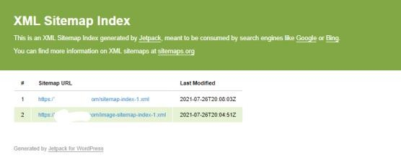
Additional Features of Technically Optimized Sites
Purpose
Ranking signal
Website factor search engines use to calculate page ranking in search
results.
Optimize speed of Website to instantly view
and interact with
content.
Ensures Website is secure
Uses
<hreflang> to help Website target different countries
Avoids duplicate content
Features
Site
Analyzes speed from
Speed different perspectives.
Ensures structured data for Website
Tool
Ensures existence of XML sitemap
Figure: XML Sitemap

Slide 9
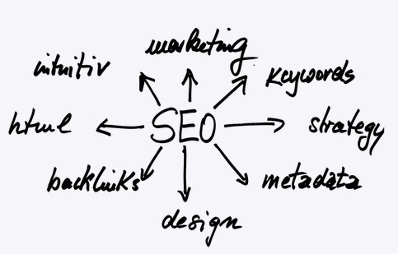
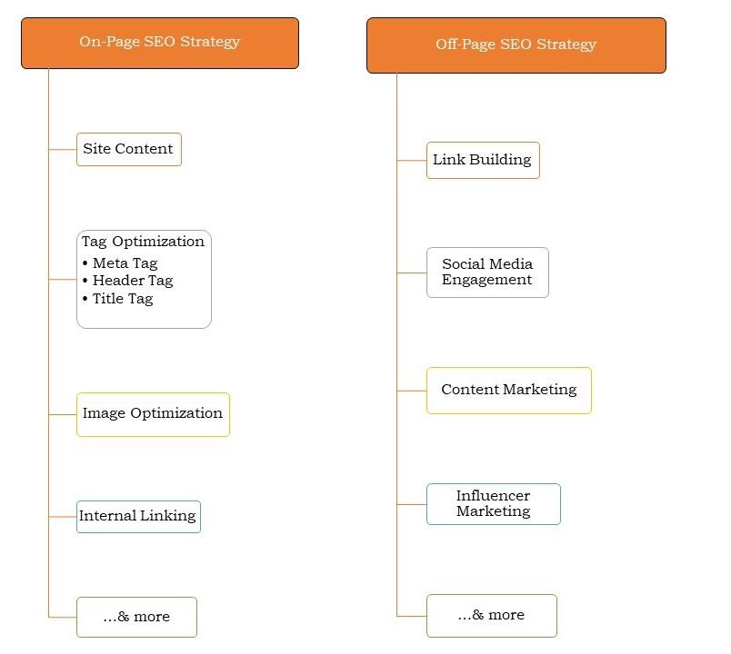
On-Page and Off-Page SEO
On-page SEO
Optimization of Content and HTML source code of individual Web pages
Off-page SEO
SEO strategies are implemented outside Website to increase authority of the site

